Slide 1
Photoelectric effect
Engineering Physics Laboratory
DR SARATHLAL K V

Slide 2
AIM
To understand the phenomenon Photoelectric effect as a whole.
To draw kinetic energy of photoelectrons as a function of frequency of incident radiation.
To determine the Planck's constant from kinetic energy versus frequency graph.
To plot a graph connecting photocurrent and applied potential.
To determine the stopping potential from the photocurrent versus applied potential graph.

Slide 3
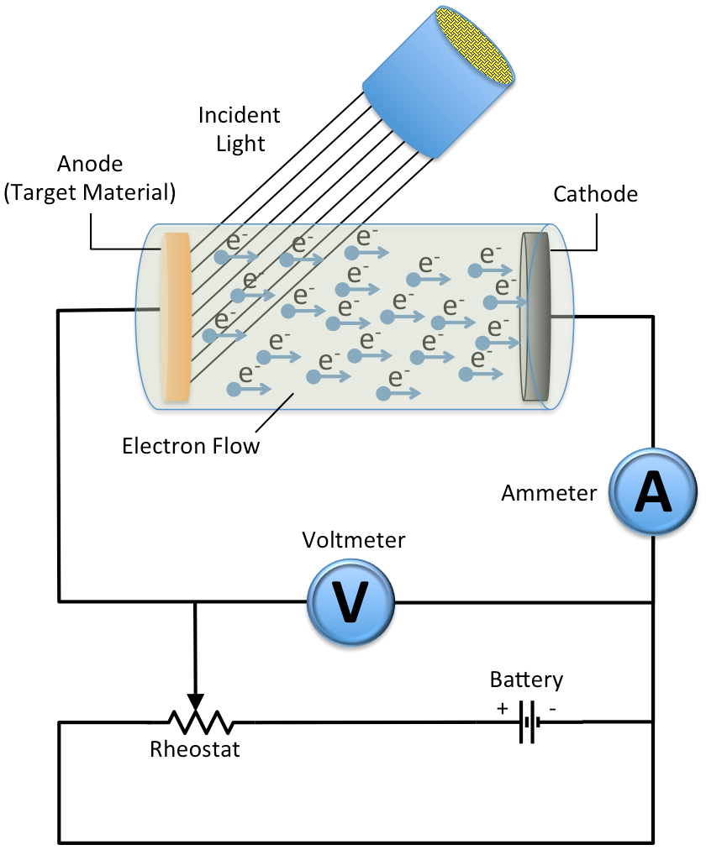
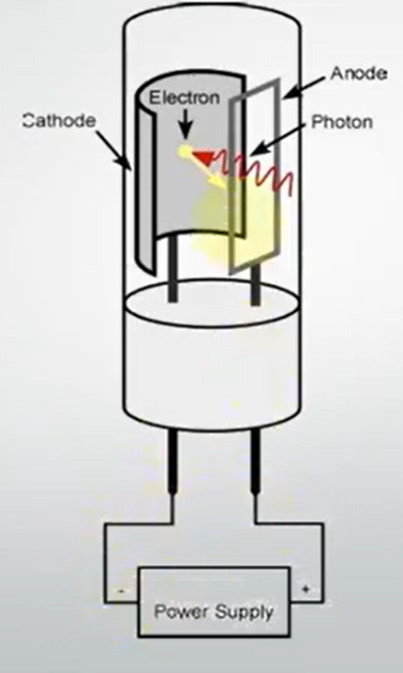
What is Photoelectric Effect

Slide 4
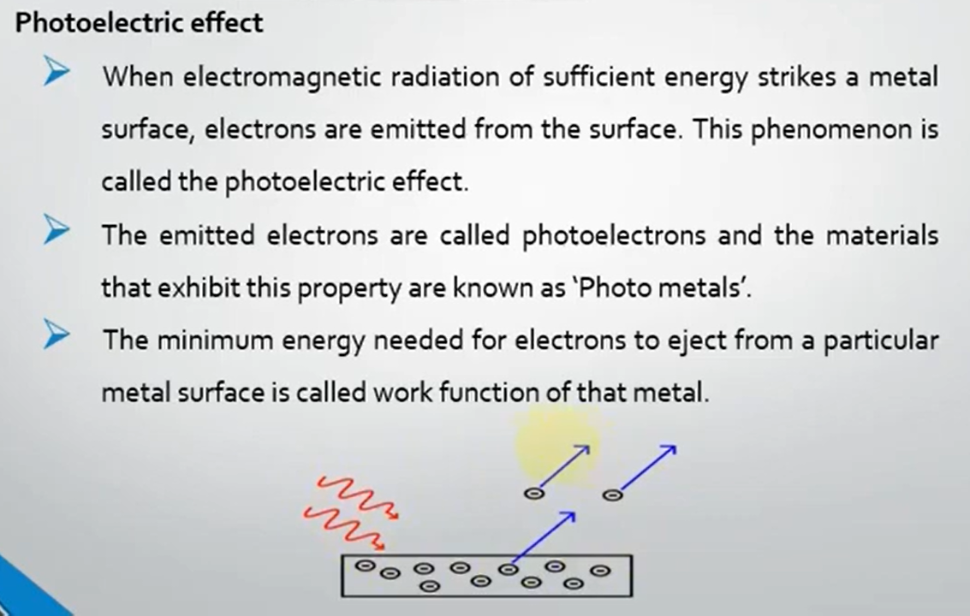

Slide 5
Observations on Photoelectric effect
The Photoelectric effect is an instantaneous phenomenon. There is no time delay between the incidence of light and emission of photoelectrons.
The number of photoelectrons emitted is proportional to the intensity of incident light. Also, the energy of emitted photoelectrons is independent of the intensity of incident light.
The energy of emitted photoelectrons is directly proportional to the frequency of incident light.

Slide 6
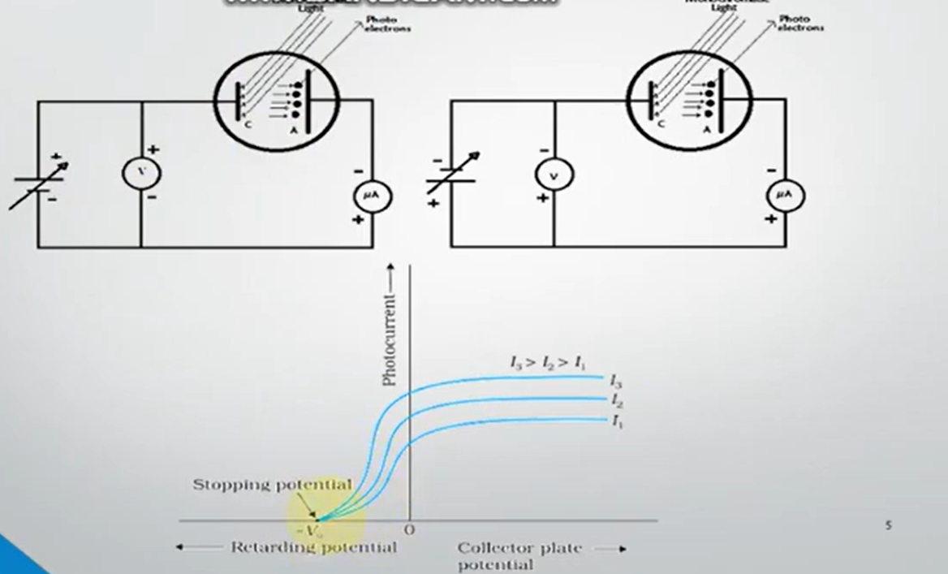

Slide 7
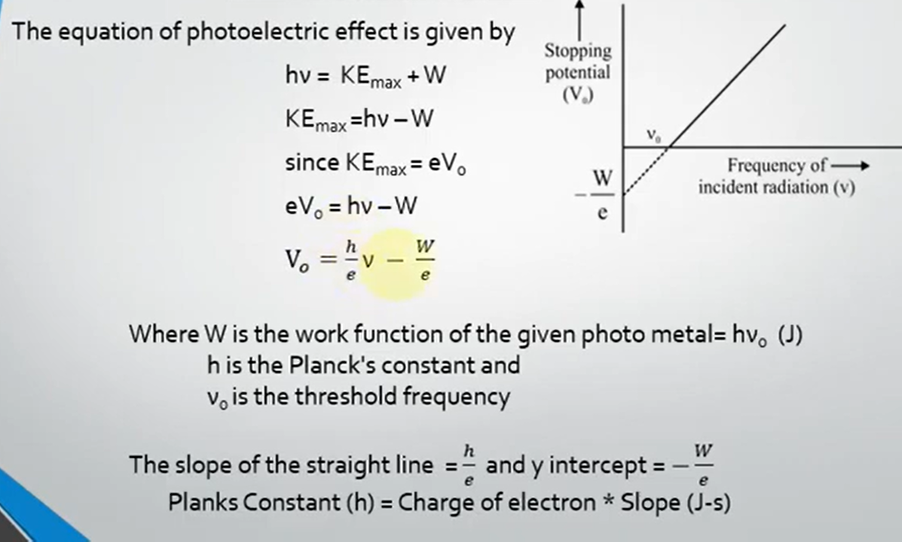

Slide 8
VIRTUAL Experiment

Slide 9
APPARATUS
Diode
Light source
voltmeter
Ampere meter

Slide 10
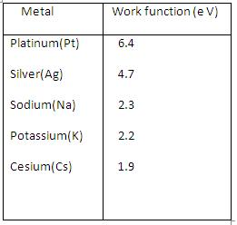
Variables

Slide 11
For performing the simulation
Select the material for studying photoelectric effect.
Select area of the material, wave-length, intensity of incident light.
Switch on the light source.
Measure the reverse current for various reverse voltages.
Plot the current-voltage graph and determine the threshold voltage.
Repeat the experiment by varying the intensity for a particular wavelength of incident light.
Repeat the experiment by varying the wavelength for a particular intensity of the incident light.

Slide 12
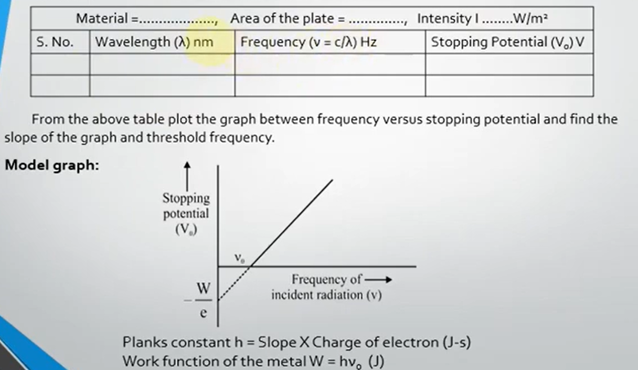
FIRST EXPERIMENT

Slide 13
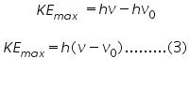
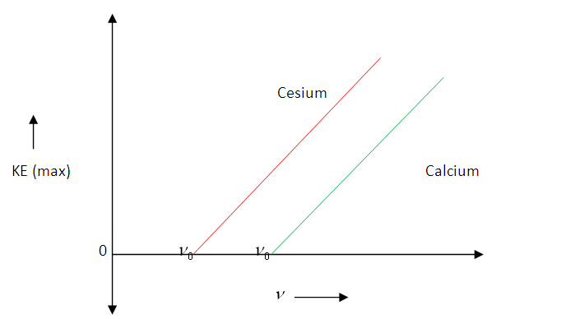
Graph connecting 'KE_{max}' and frequency:
Maximum kinetic energy of photoelectrons versus frequency of incident radiation graph

Slide 14
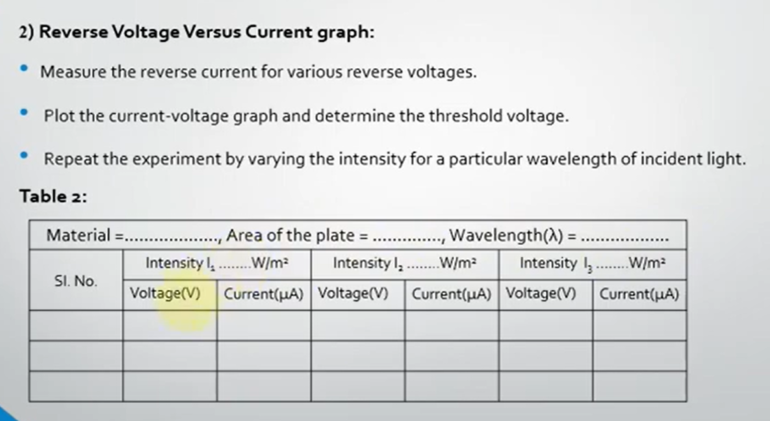
EXPERIMENT 2

Slide 15
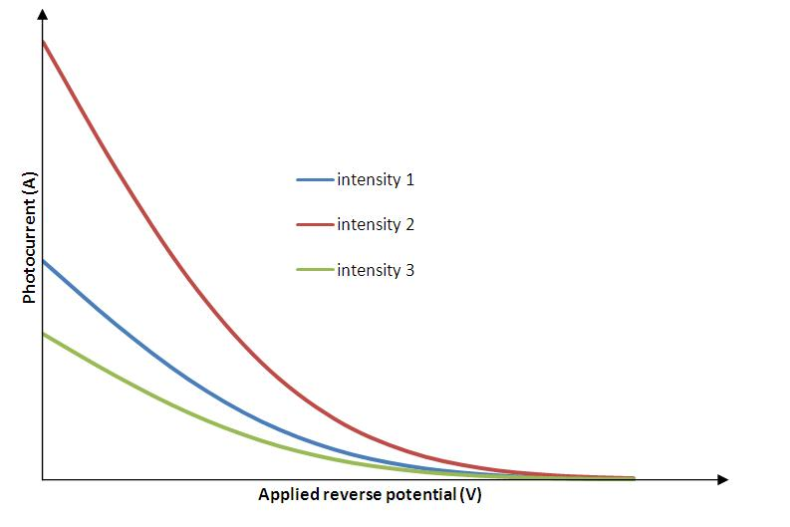
For constant frequency and different intensities

Slide 16
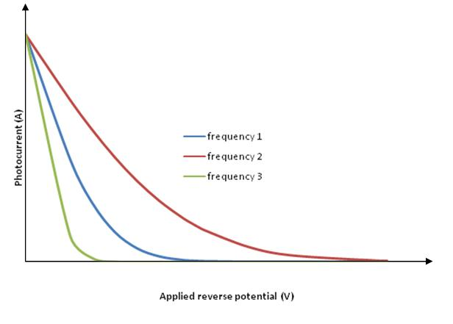
EXPERIMENT 3-GRAPHS: For constant intensity and different frequencies
Material-……………………..
Area of the plate………………………….
Intensity - ……………………………..
 | Frequency=.... Voltage Current | Frequency=… Voltage Current | Frequency=… Voltage Current
1
2

Slide 17
VIRTUAL Experiment Link
http://vlab.amrita.edu/?sub=1&brch=195&sim=840&cnt=1

